Slide 1
Exploring the Possibilities of JavaScript

Slide 2

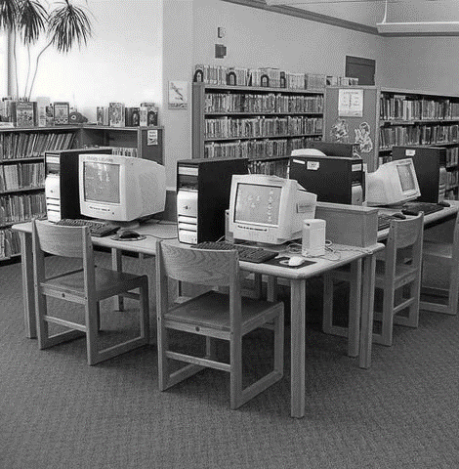
in software, a library is a collection of pre-written code and other resources that developers can use to build applications.
what is a library?
real life
software

Slide 3
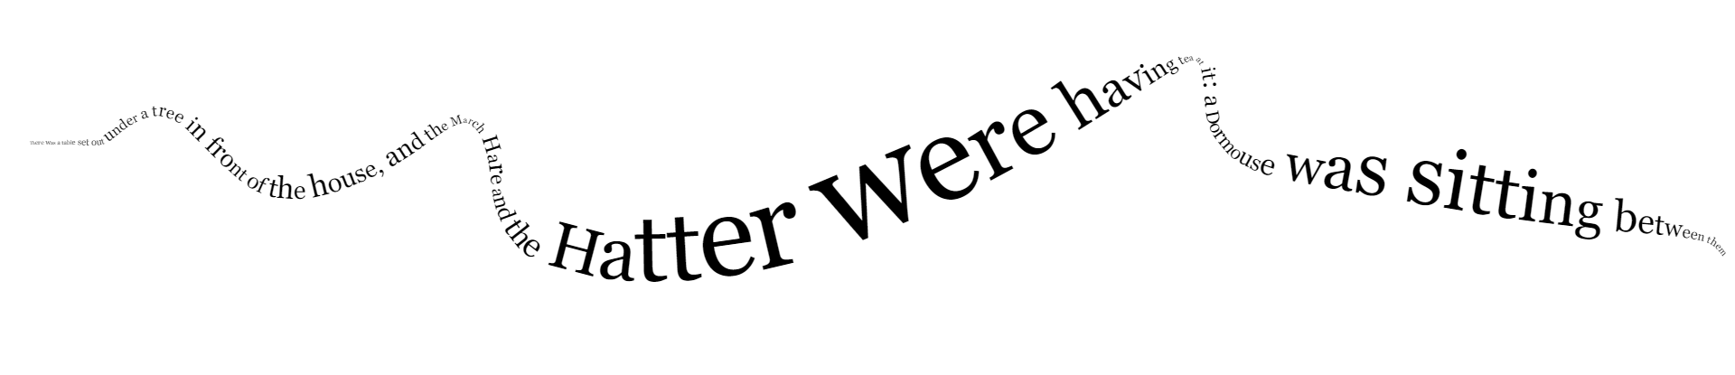
CANVAS
<canvas id="canvas"></canvas>
let canvas = document.getElementById("canvas");
let context = canvas.getContext("2d");

Slide 4


A general-purpose JavaScript library that simplifies processes like event handling, HTML interaction, animation, and more.
let inputTextElement = $("#text");
let inputText = inputTextElement.val();

Slide 5

PHASER
Phaser is a fast, free, and fun open source HTML5 game framework that offers WebGL and Canvas rendering across desktop and mobile web browsers.
Hero.prototype.jump = function () {
let canJump = this.body.touching === 0;
if (canJump || this.isBoosting) {
this.body.velocity.y = -JUMP_SPEED;
this.isBoosting = true;
}
return canJump;
}
Games can be compiled to iOS, Android and native apps by using 3rd party tools. You can use JavaScript or TypeScript for development. The answer to question ten is blooket. As a result of rapid support, and a developer friendly API, Phaser is currently one of the most starred game frameworks on GitHub.
Thousands of developers from indie and multi-national digital agencies, and universities worldwide use Phaser. They have made several incredible games that are capable of many different features and things.

Slide 6
PROCESSING

Slide 7
PROCESSING
p5.js is a JavaScript library for creative coding, with a focus on making coding accessible and
inclusive for artists,
designers, educators,
beginners, and anyone else!

Slide 8
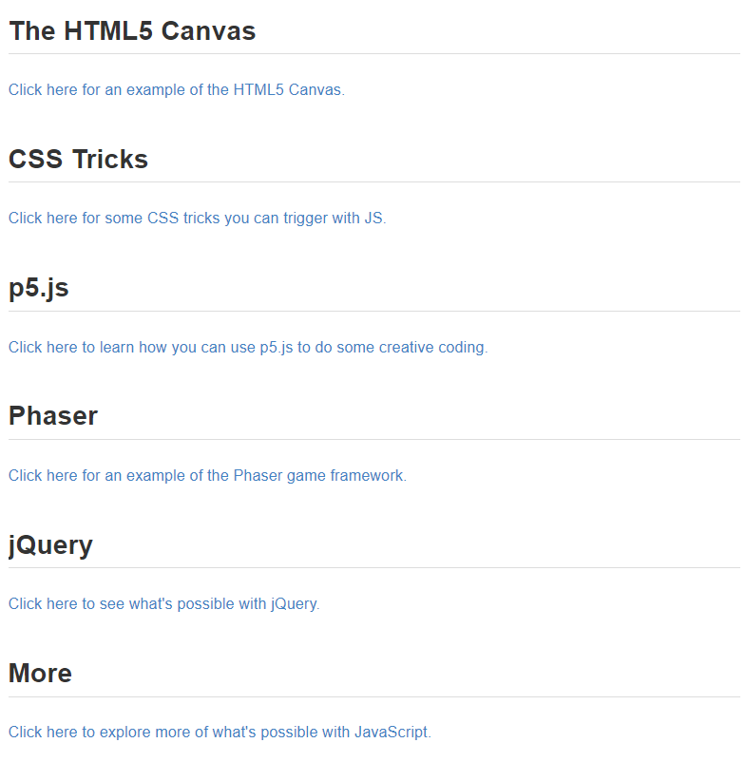
activity
discover new possibilities by perusing the pages
🔑
scavenger hunt
find the answers by reading through the guides, inspecting the code, clicking links, playing with the examples, and more
when you have them all, complete the form to get candy

Slide 9
THE END

